Slide 1
ITKv4 Workflow/Process
Getting from here to there
Bill Hoffman
bill.hoffman@kitware.com

Slide 2
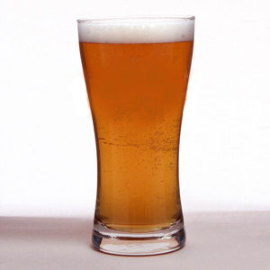
“dogfooding” or “Drinking Our Own Champagne”
Eating your own dog food
From Wikipedia, the free encyclopedia
Eating your own dog food, also called dogfooding, is when a company uses the products that it makes
For ITK lets say:
“Drinking our own beer”

Slide 3
ITK Software Development 2.0
Modernize the ITK software process
Easier to accept contributions
Easier to move forward
One of the deliverables of the Kitware ITKv4 effort will be this new process
We need to use the process to developer ITKv4 (drink our own beer)

Slide 4
Overview
CMake git based workflow
Titan workflow
ITKv4 workflow
Current
Future
Scrum at Kitware (project managment process)
Application to ITKv4 effort

Slide 5
CMake Branchy Workflow
master
some-topic
next
Git Stage Repository
$ git checkout master
$ git pull
$ git checkout –b some-topic
$ git push stage HEAD
$ ssh git@cmake.org stage cmake print
$ ssh git@cmake.org stage cmake merge -b next some-topic
Weekly never ending candy merge

Slide 6
Stage Tracks master and next merges
$ ssh git@cmake.org stage cmake print
cmake-gui-args-11388 | master=0 next=1
AddIARSupport | master=0 next=0
add-ProcessorCount-module | master=0 next=1
qtdialog-use-bundleutilities | master=0 next=1
PreferCMakeModulesByCMakeModulesWithPolicy | master=0 next=0
dev/strict-mode | master=0 next=1
FixBisonWithLocale | master=0 next=1
improve-HTML-test | master=0 next=1
CheckCompilerFlag-foreign-MSVC | master=0 next=1
document-custom-command-no-DEPENDS | master=0 next=1
issue_10201 | master=0 next=1
fix_osf_build | master=0 next=1

Slide 7
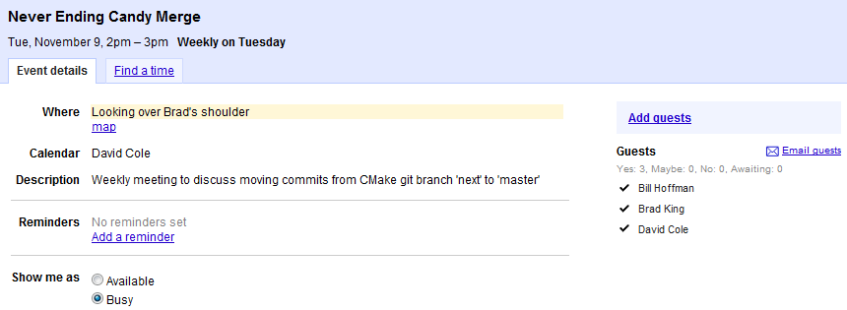
CMake allows only a few to merge to master

Slide 8
CMake and the Bug tracker

Slide 9
What is Titan?
Informatics toolkit.
Collaborative effort between Sandia National Laboratories and Kitware, Inc.
Significant extension of VTK:
Support the ingestion, processing and display of informatics data.
Flexible, component based pipeline.
Fields such as intelligence, semantic graph and information analysis.
Notes:
The Titan Informatics Toolkit is a collaborative effort between Sandia National Laboratories and Kitware Inc. It represents a significant expansion of the Visualization ToolKit (VTK) to support the ingestion, processing, and display of informatics data. By leveraging the VTK engine, Titan provides a flexible, component based, pipeline architecture for the integration and deployment of algorithms in the fields of intelligence, semantic graph and information analysis.

Slide 10
Titan: Source Code Management
New Git repository developed over last year.
Designed to share Git submodules
Seven Git submodules at present.
Also downloads source tarballs for other dependencies.
Aim to get developers/users up and running quickly.
Builds dependencies such as VTK, Qt, Trilinos, curl, HDF5, Google protocol buffers.
Can optionally build against system versions.
The entire repository (including tarballs) can be downloaded – builds on non-networked machines.

Slide 11
Titan: Build System
New CMake based build system.
Extensive use of external projects.
Drive the build of Qt (from source tarball).
Drives the build of VTK, Trilinos from the source tree in Git submodules.
Largely use Git to pin a submodule.
Move to newer versions when desired.
Titan has a lot of dependencies.

Slide 12
Titan: Workflow
master
some-topic
next
Employ a branchy workflow.
Using the topic stage to merge.
Dashboards test master and next.
All developers can merge to both.
Policy that all C++ code tests out in next before being merged into master.
Stage provides overview of active topics.
I largely manage submodules and third party libraries – VTK moved often.

Slide 13
Process needs to work from day one
Just like CMake evolved with the original ITK effort, the process for ITKv4 will evolve as well
Gerrit for review
Topic Stage for merging
CDash@HOME for testing
Eventually Gerrit will take over topic stage

Slide 14
Scrum at Kitware
14

Slide 15
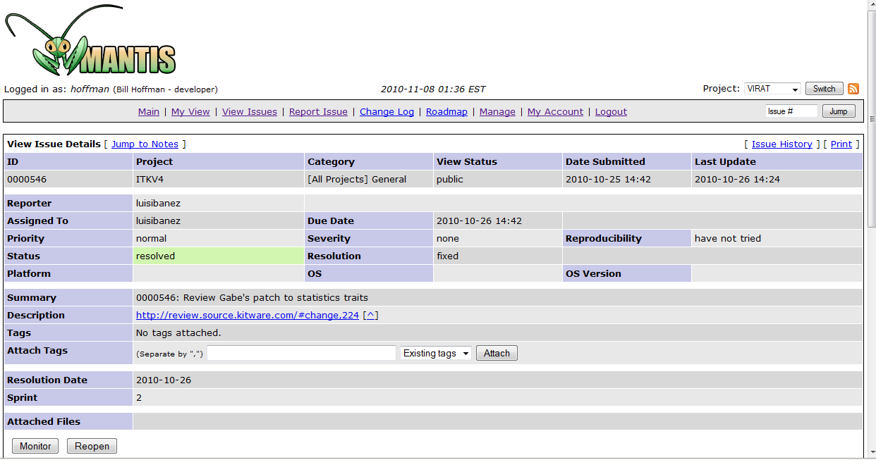
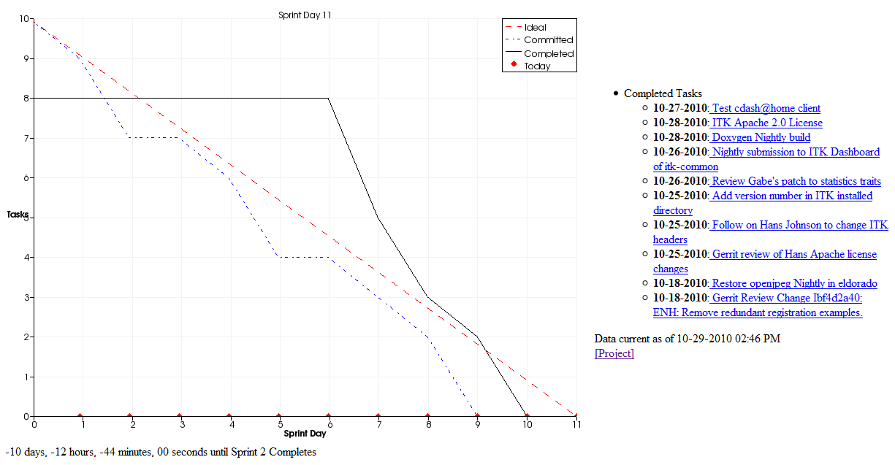
Mantis used to track workflow

Slide 16
ITKv4 Tcon Scrum Proposal
Change the weekly TCON to be Scrum based
Have Mantis tasks that we track for each group
Each group signs up for a group of tasks and reports on progress each week
Tasks
Gerrit reviews
Bug’s assigned to you

