Slide 1
Fast Non-Local Means (NLM) / UINTA Denoising
Ross T. Whitaker, Suyash P. Awate, Kristen Zygmunt
Scientific Computing & Imaging (SCI) Institute

Slide 2
Fast Non-Local Patch-Based Denoising

Slide 3
Fast Non-Local Patch-Based Denoising
Aims
  Non-Local Means (Buades at al. 2005 CVPR) / UINTA (Awate & Whitaker 2005 CVPR) denoising within ITK framework
  Computational efficiency using multithreading & efficient patch searches
  Incorporating noise models using Bayesian schemes

Slide 4
Aim 1 : Non-Local Means Image Filter
Generic framework denoising images having multi-dimensional domains and values
  Scalar
  Vector (e.g. multimodal MRI)
  Tensor (e.g. DTI)

Slide 5
Aim 2 : Computational Efficiency
Multithreading on multiprocessor or multicore shared-memory machines
Memory efficiency in handling patch data structures
Efficient searching of similar patches in image
  Pre-filtering schemes
  Space-subdivision schemes

Slide 6
Aim 3 : Noise Models
Noise-model examples
  Gaussian, Rician, Poisson
Bayesian denoising
  NLM/UINTA impose an MRF prior on image data
  Noise model introduces a likelihood term
  Free parameter (Lambda) balances two terms

Slide 7
NLM / UINTA Project Status

Slide 8
NLM / UINTA Project Status
Code design / implementation
  ☑ Basic design implemented in ITK framework
  ☑ Functional test written
  ☐ Provide support for all pixel types
  ☑ Scalar
  ☐ RGB / Vector
  ☐ Tensor
  ☐ Finalize design based on your feedback

Slide 9
NLM / UINTA Project Status
Testing
  ☐ Confirm functionality
  ☐ Test CPU performance
  ☐ Test memory performance
Prepare Insight Journal Article
  ☐ Code
  ☐ Documentation
  ☐ Test images

Slide 10
ITK Class Hierarchy for NLM / UINTA Denoising

Slide 11
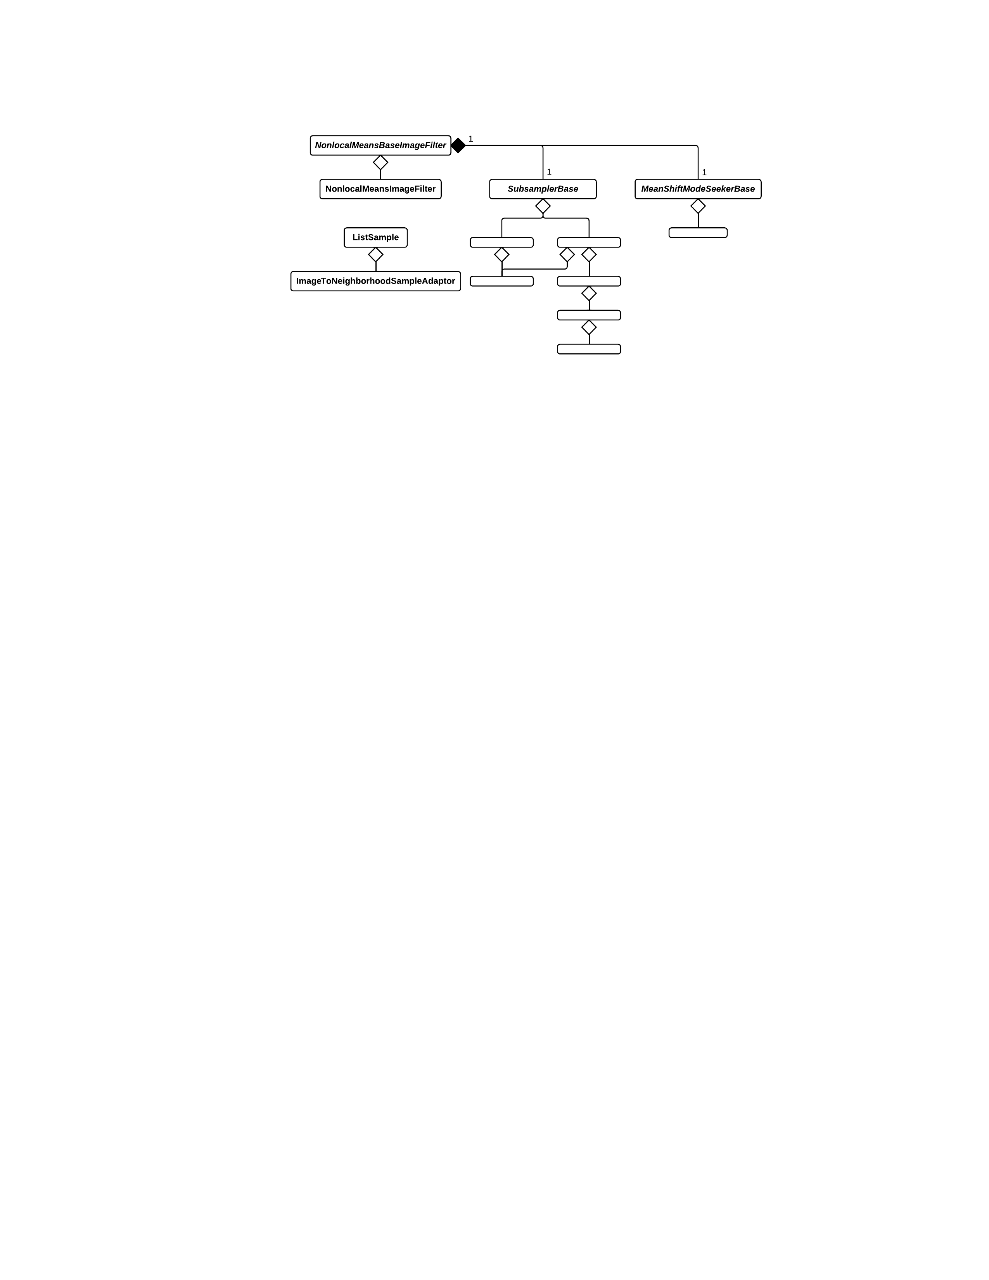
NLM/UINTA ITK Class Hierarchy

Slide 12
API: NonLocalMeansBaseImageFilter
Similar to FiniteDifferenceImageFilter
Pixel types:
  Scalar
  RGB
  Vector
  Tensor

Slide 13
API: NonLocalMeansBaseImageFilter
Defines abstract algorithm for NLM / UINTA
  GenerateData()
  {
    Initialization and Allocation
    PreProcessInput()
    while (! Halt())
    {
      InitializeIteration()
      ComputeSigmaUpdate()
      ComputeImageUpdate()
      ApplyUpdate()
    }
    PostProcessOutput()
  }

Slide 14
API: NonLocalMeansImageFilter
API similar to DenseFiniteDifferenceImageFilter
Internals similar to SampleSelectiveMeanShiftBlurringFilter
Subclass to provide other statistical estimation schemes

Slide 15
API: NonLocalMeansImageFilter
Multithreaded implementations :
  ComputeSigmaUpdate()
  ComputeImageUpdate()
  ApplyUpdate()
User supplies :
  Subsamplers
  Neighborhood weights

Slide 16
ImageToNeighborhoodSampleAdaptor
Patch Data Type:
  ConstNeighborhoodIterator
Provides patches from an image
Patches are not copied around everywhere, avoiding large data structures
Patches accessed via indirection only for computation involving that particular patch

Slide 17
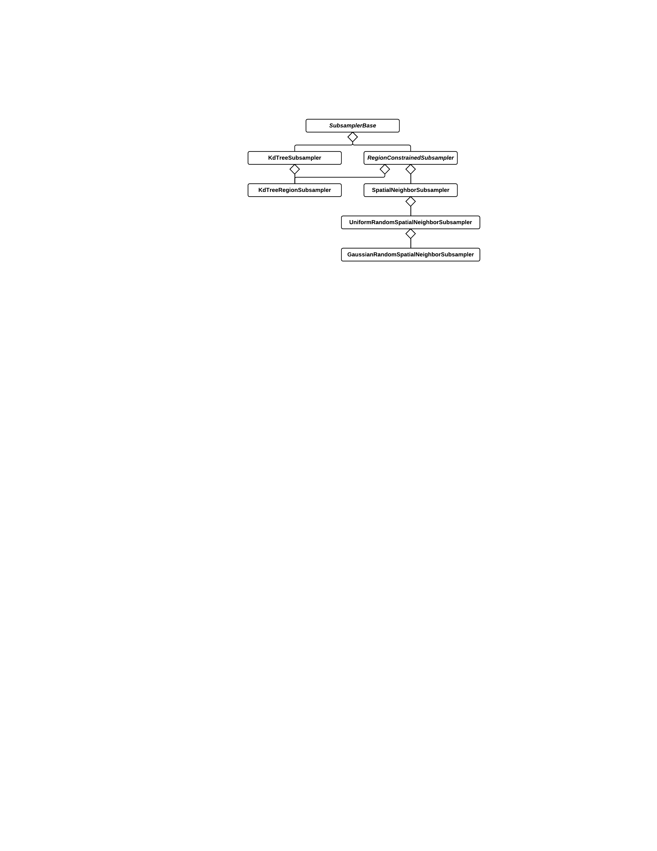
Subsampler Hierarchy

Slide 18
SubsamplerBase
Abstract interface to create subsamples
  SetSample() / GetSample()
  Search (InstanceIdentifier query,
  SubsamplePointer& results)
  Combines APIs from KdTree and SampleToSubsampleFilter
  Flexible Input/Output types
  Search API not Update API

Slide 19
SubsamplerBase Derived Classes
RegionConstrainedSubsampler
  All selected patches are within given region
SpatialNeighborSubsampler
  Select all patches within spatial radius of query
GaussianRandomSpatialNeighborSubsampler
  Select normal distribution of patches within spatial radius of query
KdTreeImageRegionSubsampler
  Select nearest patches in the k-d space

Slide 20
ITK-Related Implementation Issues

Slide 21
Other ITK Contributions
Wrote bug report #12152 that identified a persistent deadlock inside the multi-threaded logger framework
Provided a test http://review.source.kitware.com/#change,1577
Provided a fixhttp://review.source.kitware.com/#change,1578
Currently going through Gerrit review process

Slide 22
Other ITK Contributions
Tested a patch supplied by Gaetan to fix the thread-unsafe MersenneTwisterRandomNumberGenerator
  Posted a message on ITK users mailing list confirming the patch workshttp://www.itk.org/pipermail/insight-users/2011-March/040391.html
  Will file bug report and provide Gerrit patch

Slide 23
Other ITK Contributions
Found problem with BoundaryFaceCalculator
  Also noticed by others http://www.itk.org/pipermail/insight-users/2011-May/040946.html
Created a test and a patch that fixed problem
  Patch found in an earlier mailing list posting
Will file bug report and Gerrit patch

Slide 24
Experiences with ITK process
Not sure how to combine Review/Statistics and main Statistics
Documentation in flux, hard to keep up with processes for v4.0, v3.20
  Git / Gerrit interplay
    Initial setup
    Revising / resubmitting patches
For bugs, should patches be submitted for both v4.0 and v3.20?

Slide 25
The End.

