Slide 1
SimpleITK Status
Bill Hoffman, Jesus Caban, Brad Lowkamp, Dan Muller, Fabrice de Chaumont, Julien Michel, Harvey Cline, Gabe Hart, Ghassam Hamarech, John Galeotti, Raghu Machiraju, Hans Johnson, Wes Turner, Luis Ibanez, Terry Yoo, Daniel Blezek

Slide 2
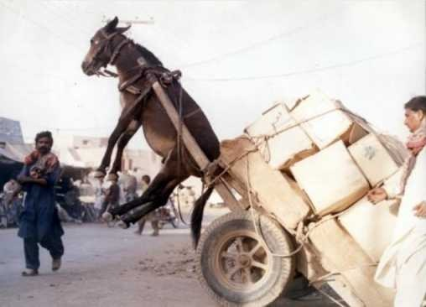
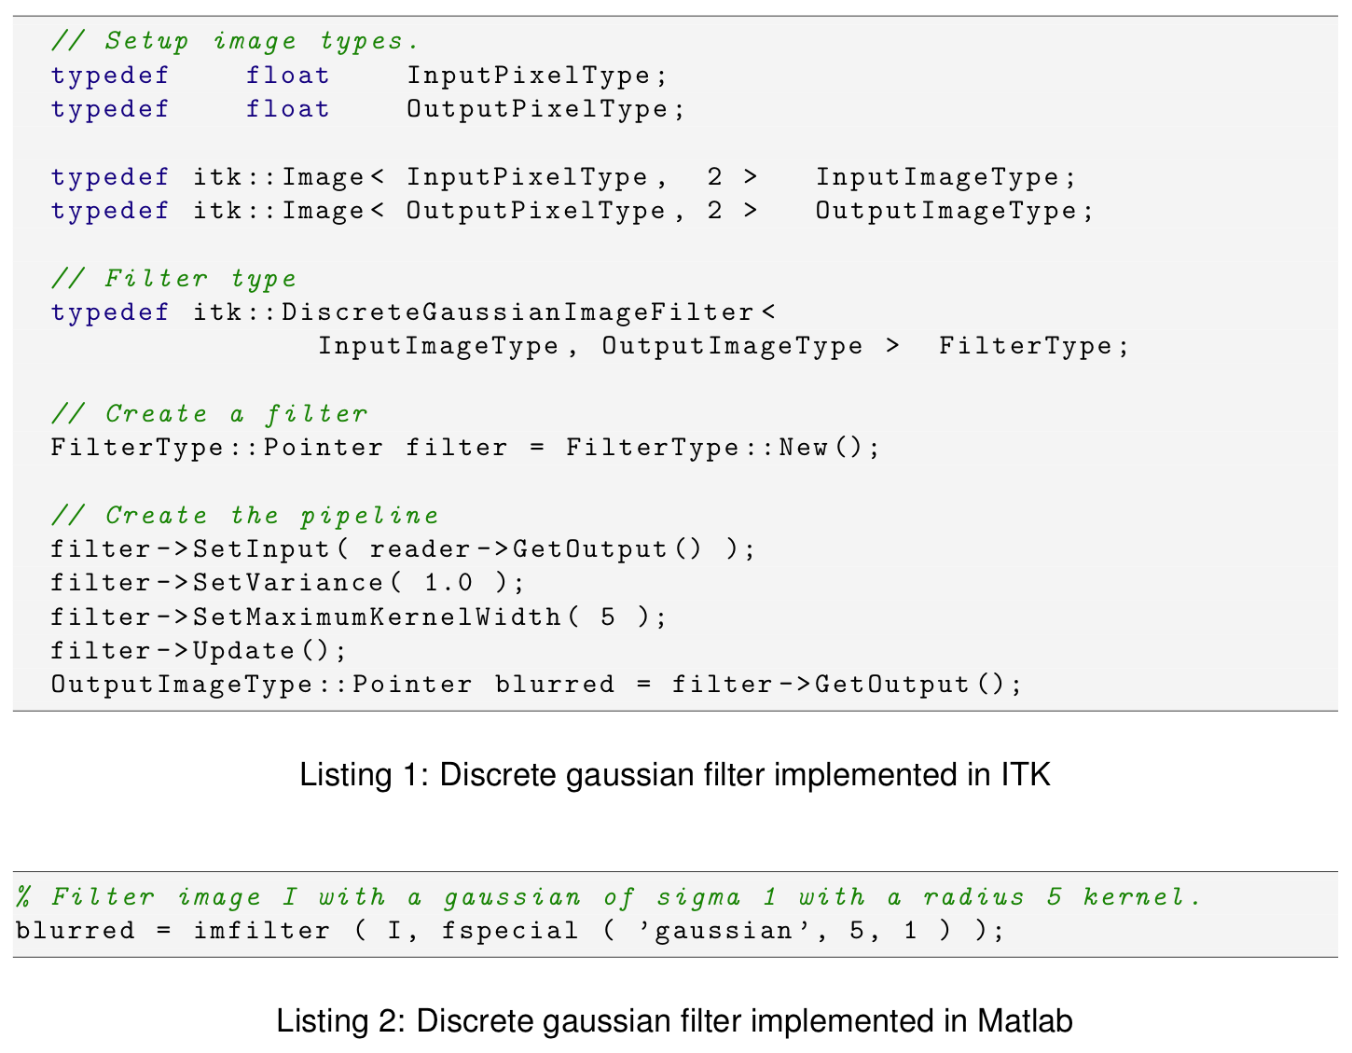
Problem

Slide 3
Problem
Doxygen for itk::Image
  42 pages long

Slide 4
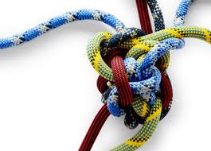
Complexity
Powerful but complex
Steep learning curve
  ever had 2 pages of compile errors?
Mainly C++
ITK often unused
  But it’s the best...

Slide 5
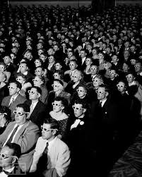
Audience
Students
Grad students
Researchers
  Microscopy
  Computer vision
  Remote sensing
Application developers

Slide 6
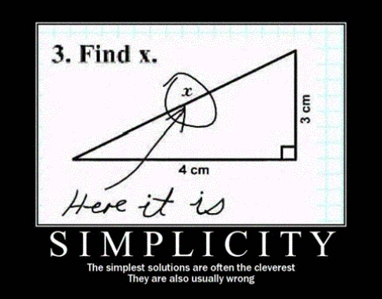
Simplify
As simple as possible
But no simpler
Simple for:
  users
  application developers
  developers

Slide 7

Goals
Simple
“On ramp”
Wrapping
Integration
  In apps
  With ITK, VTK, etc
Extensible

Slide 8
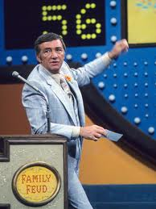
Survey Says!
214 respondents
Takeaways
  Compiled packages
  3D & 4D
  Out of core processing
  Object model
  char, short, float/double, vector
  Visualization
Gabe Hart

Slide 9
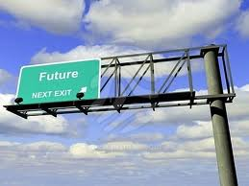
Decisions
API
Datatypes
Dimensionality
Pipeline?
Out of core processing
Wrapping
Distribution

Slide 10
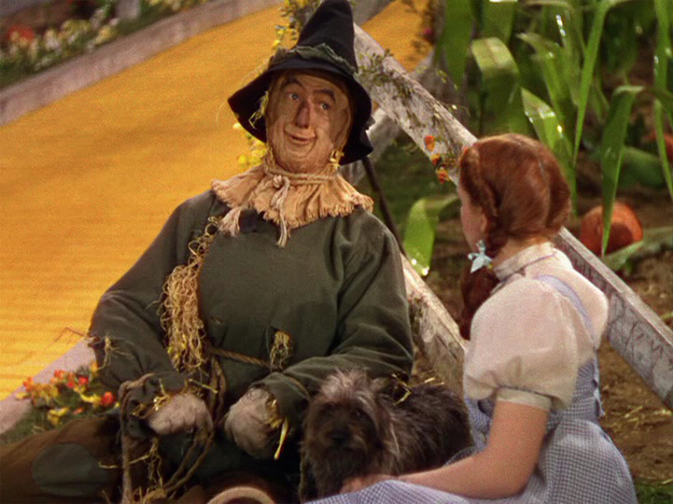
Strawman Proposal
Object model
3D images (& slice-by-slice for 2D)
  4D as vector of images
  char, short, float (double?)
No exposed pipeline
Out of core orchestration framework
  VOI readers/writers
  Call list of filters / handle boundaries
SWIG wrapping

Slide 11

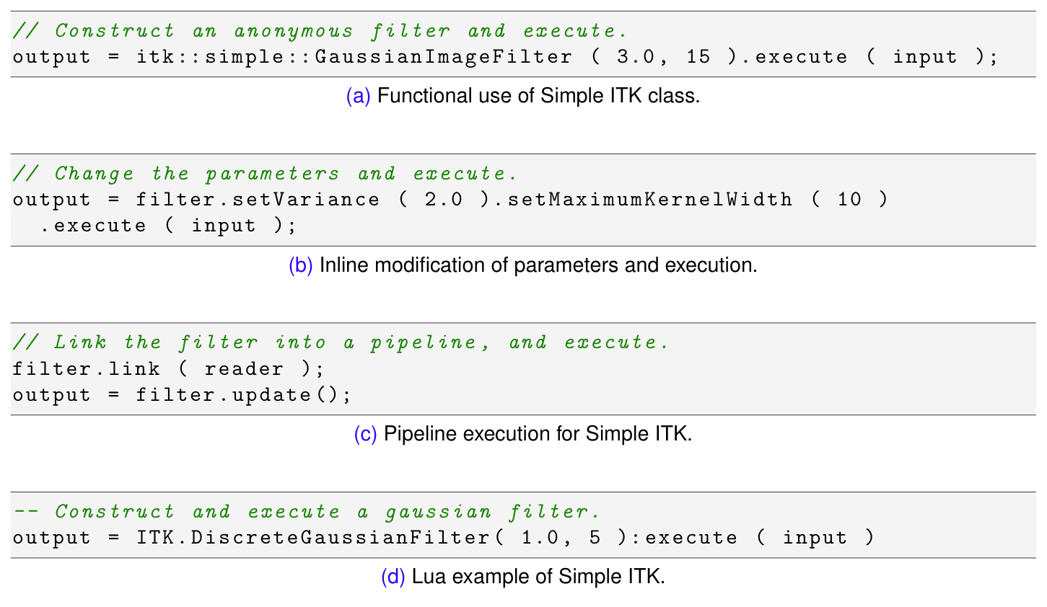
API
Procedural / functional?

Slide 12
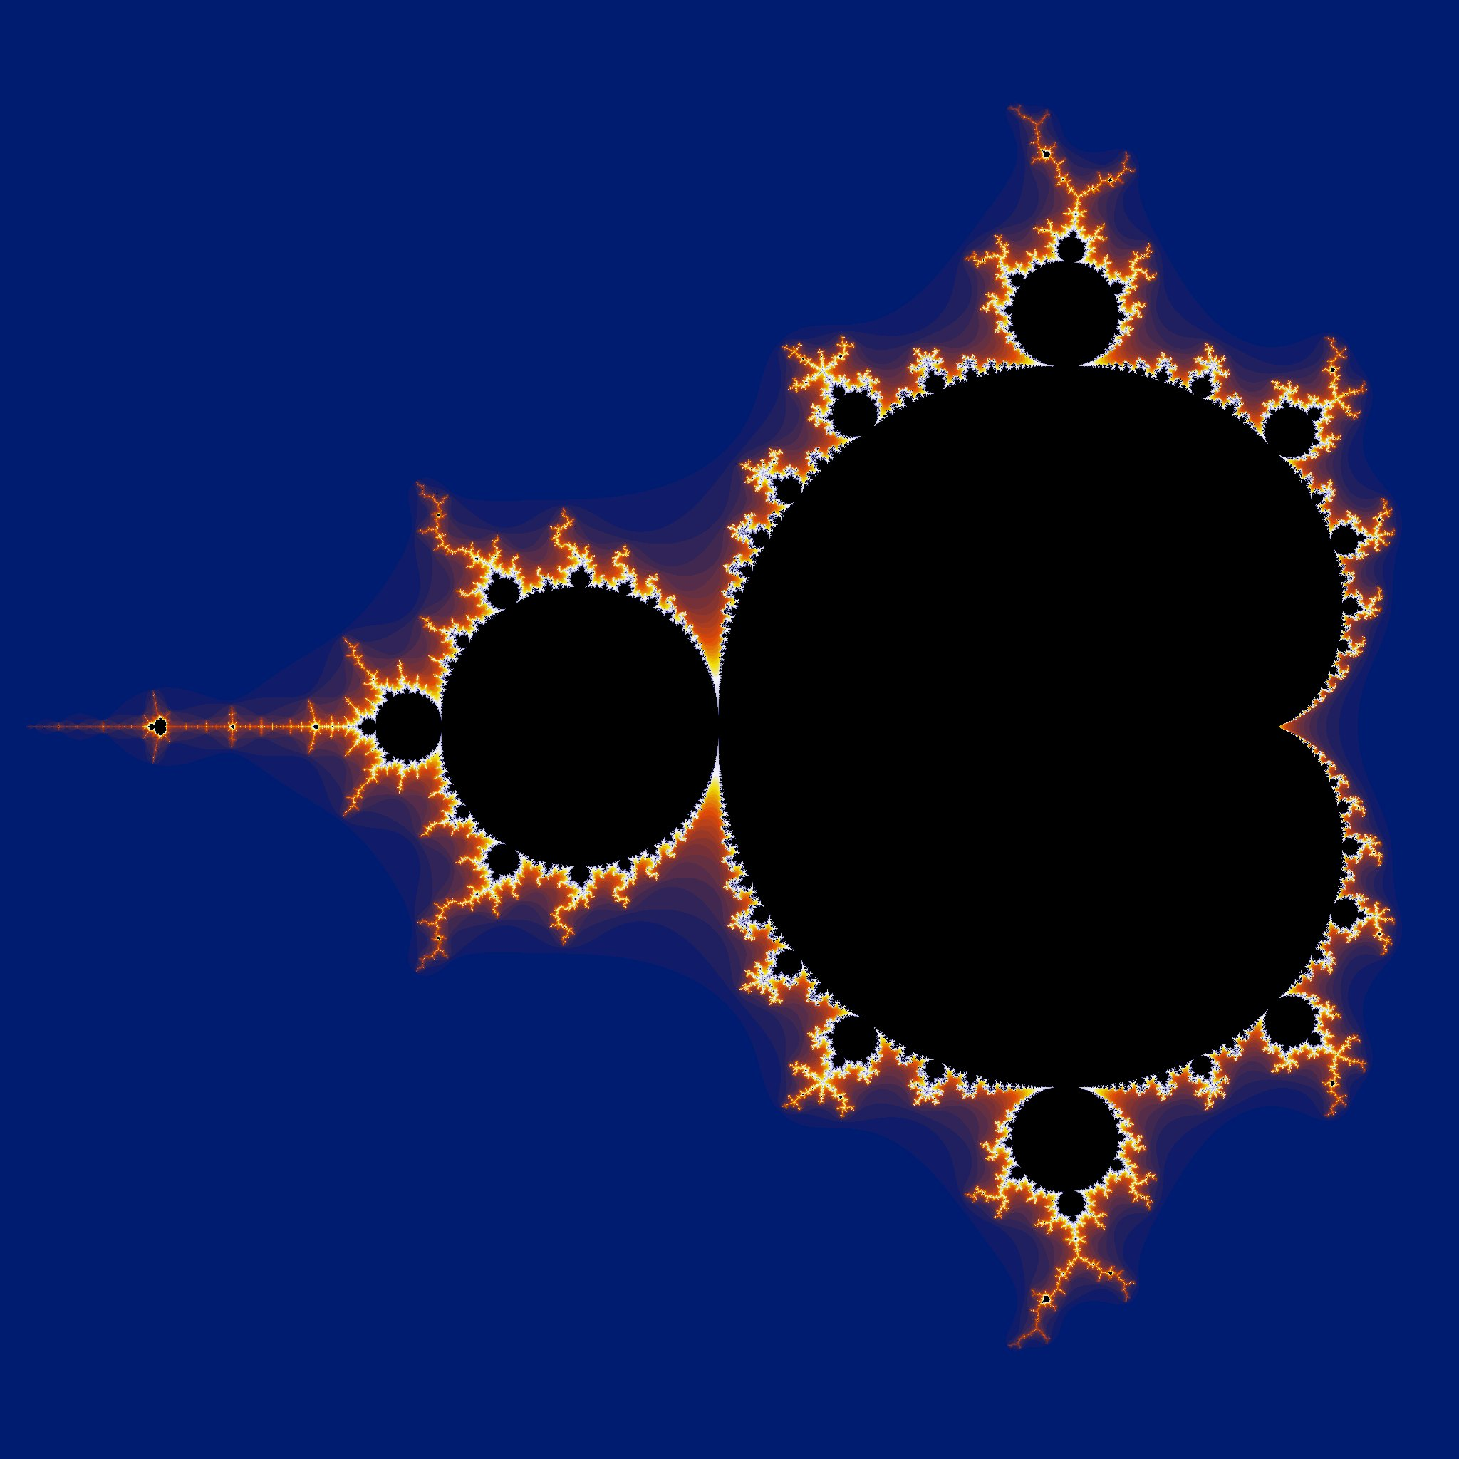
Data types
Which to support?
  Scalar in all filters?
  Vector in limited set?
How to support?
  Dynamic loading?
  Compile time configured?
  Template meta programming?
  Macros?

Slide 13
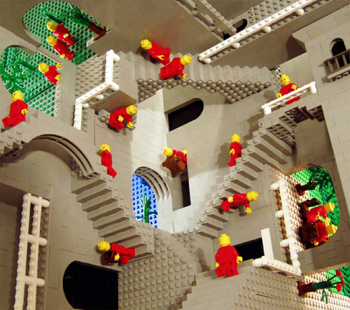
Dimensionality
3D critical
4D nice
How to support?
  4D == 4D itk::Image?
  4D == vector of 3D images?
  4D == 3D with vector pixels?

Slide 14
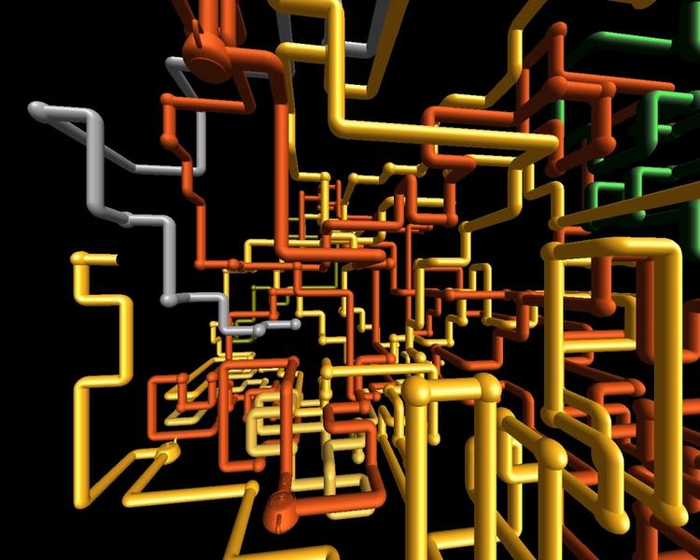
Pipeline
Unnecessary complexity
Utility in streaming
  Not (fully) implemented in ITK

Slide 15
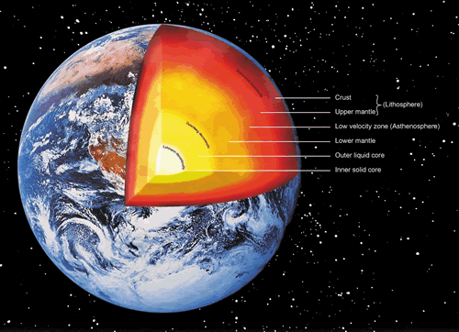
Out of core processing
Essential
  ITK Pipeline?
  OpenCL model?
    single pixel kernel pixel
    called for all pixels
    “orchestration” framework

Slide 16
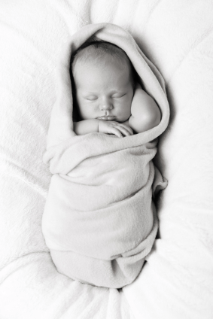
Wrapping
SWIG
Languages
  Matlab
  Python
  Java
  C#
  Others: Tcl, R, Perl, Ruby...
Interact with WrapITK nice to have

Slide 17
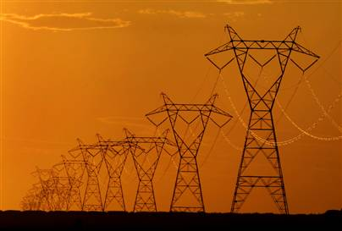
Distribution
Binary
  Matlab (somehow)
  Python egg
  Java jar
  C++ lib/dll/so & include
Source
  Less useful

Slide 18
SimpleITK Status
Bill Hoffman, Jesus Caban, Brad Lowkamp, Dan Muller, Fabrice de Chaumont, Julien Michel, Harvey Cline, Gabe Hart, Ghassam Hamarech, John Galeotti, Raghu Machiraju, Hans Johnson, Wes Turner, Luis Ibanez, Terry Yoo, Daniel Blezek

