Slide 1
Modularization
ITK modularization
Bill Hoffman
bill.hoffman@kitware.com

Slide 2
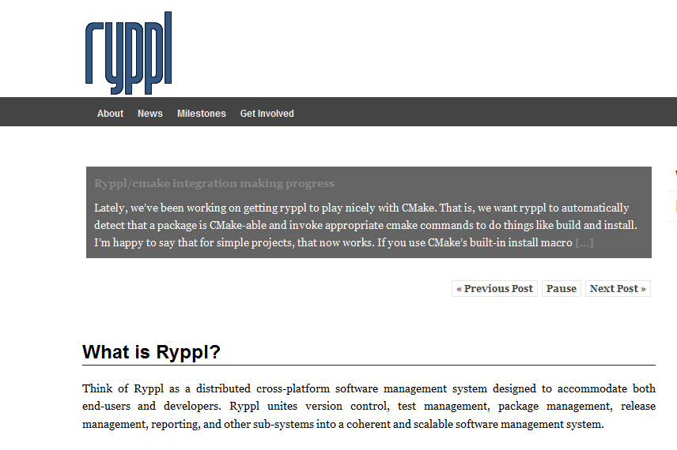
We are not alone…
Qt modularization effort
Boost modularization effort Ryppl

Slide 3
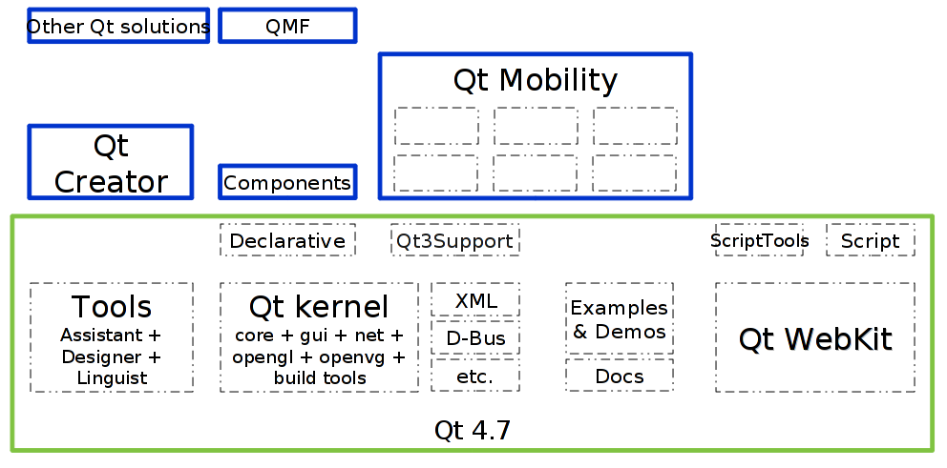
Qt

Slide 4
ExternalProject_add
Module introduced in CMake 2.8
Allows the download, configure, build and install of software via custom commands
Kitware Source Article: October 2009
http://www.kitware.com/products/html/BuildingExternalProjectsWithCMake2.8.html
ARL CSE
Avoid the Easter Egg Hunt!

Slide 5
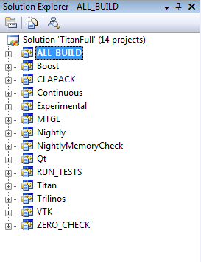
Titan Example
Titan
Google
Protocol
buffers
CLAPCK
VTK
Qt
Trilinos
Curl
Boost

Slide 6
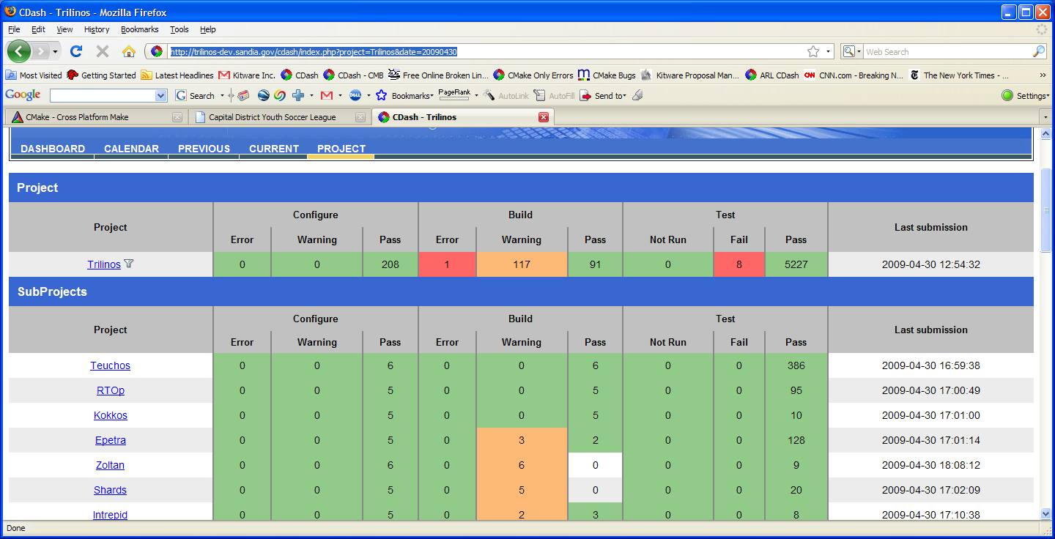
Trilinos (Multi-Package Dashboard) http://trilinos-dev.sandia.gov/cdash/index.php
Main Project
Sub Projects

Slide 7
git sub-modules
http://chrisjean.com/2009/04/20/git-submodules-adding-using-removing-and-updating/

Slide 8
Having our cake and eating too, ITK two ways
itk-complete
All of ITK with git sub-modules for each
For ITK developers
itk-optional
An ExternalProject_add version that checks out each sub-module as needed
For applications using ITK

Slide 9
Module Dependencies
A git sub-module itk-depends
CMake Code for handling module depend information
The depend information for each module
Used by both itk-complete and itk-optional
Exploring ways to keep the depend information on branches in each modules git

Slide 10
Proof of Concept
git clone git://itk.org/itk/itk-complete.git
git clone git://itk.org/itk/itk-optional.git

Slide 11
Allows for Expansion Outside Main Repository
Anyone should be able to create an ITK module, and have it work in this system
Each module should contain
Source
Tests
Depend information
Documentation

Slide 12
Demos
cmake-gui turn on off modules
Load itk-optional in VS

Slide 13
The Hard Part….
We need to partition ITK

